Slide 1





Introduction
Problem
Solution
1
LaunchPad Pitch
Team 01: Victoria, Sumneet, Parakh, Yongqian, Pratiksha

Slide 2



Introduction
Problem
Solution
2
Who here enjoys doing chores?

Slide 3
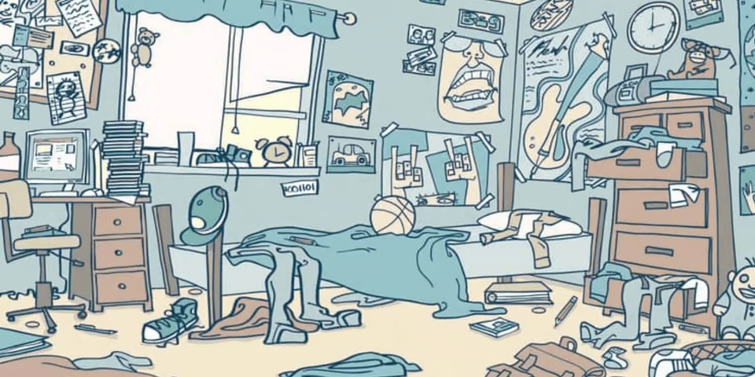
Introduction
Problem
Solution
2
On average, we spend 6 hours a week on household chores
nearly 14 hours per week when including tasks such as deep cleaning, lawn care and grocery shopping
2018 ACI National Cleaning Survey

Slide 4


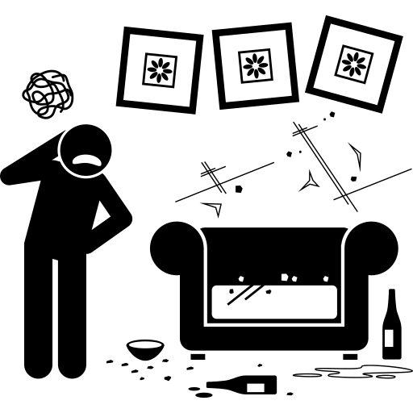
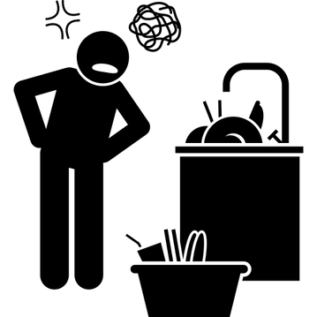
Introduction
Problem
Solution
3
For most people, household chores feel like a drag.
No motivation
No excitement
No sense of accomplishment

Slide 5
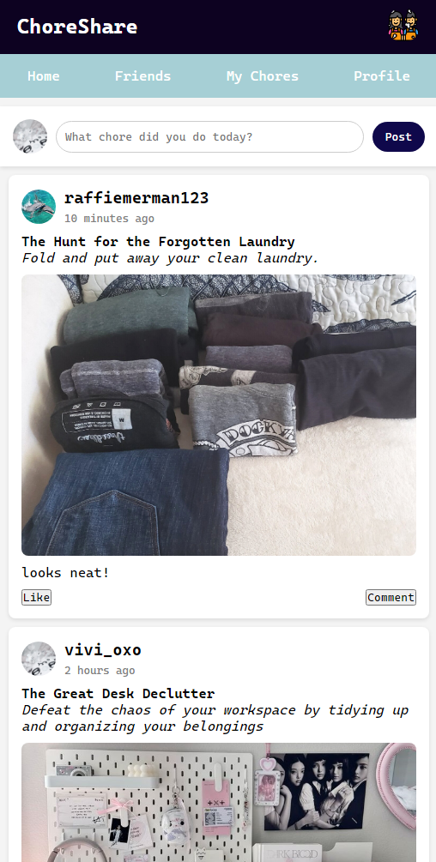
Introduction
Problem
Solution
Sign Out
4
ChoreShare
01
Improve your life by turning every chore into an accomplishment
Upload photos of yourself completing chores Get motivated by seeing who's topping the leaderboard in your community
02
03
Use Gemini AI to help generate your chores list

Slide 6
Introduction
Problem
Solution
Sign Out
5
DEMO

Slide 7


Introduction
Problem
Solution
Sign Out
6
ChoreShare improves your life by gamifying a mundane necessity
Become a sticky, engaging platform that motivates users to record, share, and engage.
Join for tracking, stay for the community
More than a chore tracker; it’s a hub for home life inspiration

